Slide 1


FEM Based Neural Networks
Seminar Presentation
Muhammad Abdullah Hassan Malik
Under Supervision of Professor Seung Hyun Lee
Department of Advanced Battery Manufacturing Systems
Korea Institute of Machinery and Materials (KIMM)
University of Science and Technology (UST)
Algorithmic Intelligence Laboratory

Slide 2
Table of Contents
Introduction
What is FEM?
FEM with Neural Networks
Literature Review
Research Proposal and Methodology
FEM-NN on R2R
PyAnsys
Workflow
Current Progress
Conclusion and Future Work

Slide 3
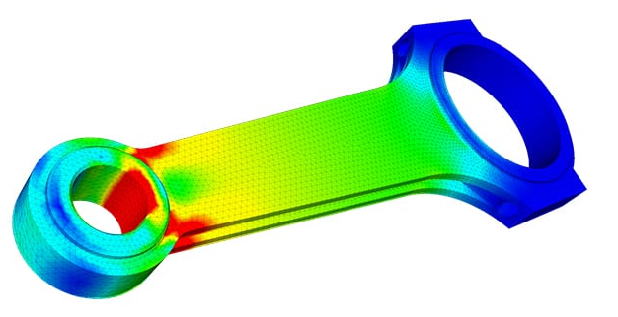
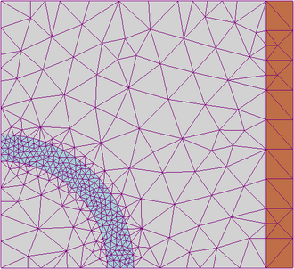
What is FEM?
FEM or Finite Element Method, is a numerical technique to simulate and analyze complex engineering problems.
It is based on the concept of breaking down the problem into small elements, and then solving equations for each element.
Most commonly used for structural stress, fluid flow, electromagnetics and heat transfer.
A Typical Stress FEM Result
FEM accelerates prototyping, design and productivity.
Elements
Examples of FEM software include
ANSYS
Abaqus
FEniCS
OpenFOAM
Mesh Pattern for an FEM Simulation

Slide 4
Why do we need FEM with Neural Networks?
FEM is powerful, but it has some key limitations:
High cost for repeated simulations.
Dependence on meshing.
Curse of dimensionality.
Difficulty of interpolation.
However, we can incorporate Neural Networks with FEM to solve some of these issues.
A trained NN can act as a surrogate for the FEM, leading to faster solve and prediction times.
The NN can learn the FEM-based patterns, allowing it to generalize on similar problems.
A good FEM-NN can result in accurate, reliable and fast results compared to just FEM.
Notes:
High cost for repeated simulations. FEM can be expensive when you need many solves with changing parameters, shapes, or loads. Neural-network surrogates can learn the mapping once and then predict much faster.
Mesh dependence. FEM needs a mesh, and creating a good mesh for complicated or changing geometries can be difficult. Neural networks can reduce this burden by learning solution patterns more flexibly, sometimes with less dependence on a fixed mesh.
It can act as a surrogate model for fast prediction after training.
It can learn physics-informed patterns so the model generalizes better than a purely data-fit surrogate.
It can reduce the amount of full FEM solving needed during design loops, optimization, or uncertainty studies.

Slide 5
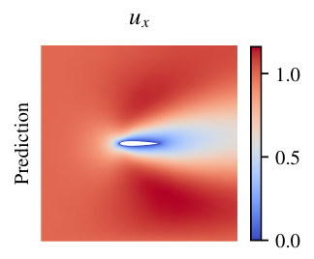
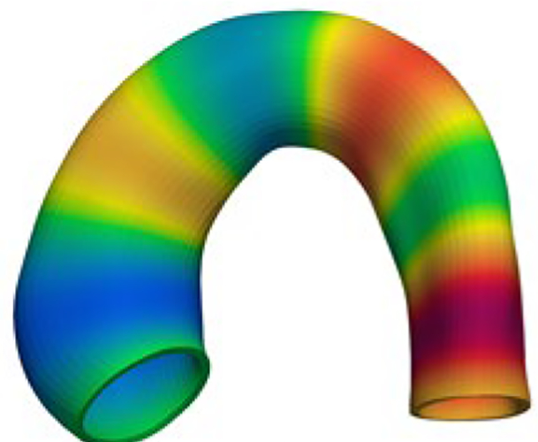
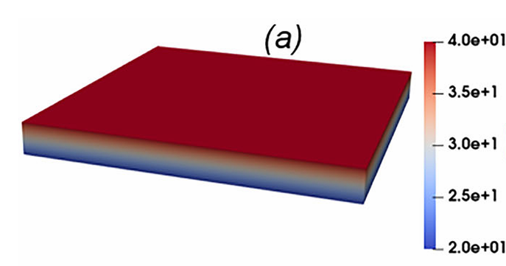
Literature Review
In existing research FEM-NN are being utilized in several capacities:
Solving Navier-Stokes flow for aircraft.
In biomechanics for aorta modelling and analysis.
Modelling fracture mechanics.
Rolling force simulation.
Thermoelastic testing.
Velocity predictions across an airfoil
by FEM-NN
Stress predictions in an aorta valve by FEM-NN
Temperature predictions in a plate by FEM-NN
Griese, F. et. al.(2024). Preconditioned FEM-based neural networks for solving incompressible fluid flows and related inverse problems. J. Comput. Appl. Math., 469, 116663.
Liang L, et. Al. Synergistic Integration of Deep Neural Networks and Finite Element Method with Applications of Nonlinear Large Deformation Biomechanics. Comput Methods Appl Mech Eng. 2023
Terrile S, López A, Barrientos A. Use of Finite Elements in the Training of a Neural Network for the Modeling of a Soft Robot. Biomimetics (Basel). 2023
Abueidda, D.W., Mobasher, M.E. I-FENN for thermoelasticity based on physics-informed temporal convolutional network (PI-TCN). Comput Mech 74, 1229–1259 (2024).

Slide 6
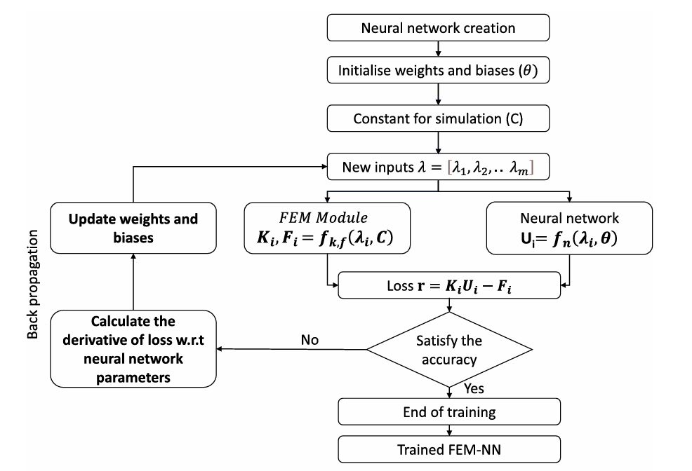
Literature Review
Many different ways to implement FEM-NN have been discussed in the literature, but the basic flow is as shown.
Rishith E. Meethal, Anoop Kodakkal, Mohamed Khalil, Aditya Ghantasala, Birgit Obst, et al.. Finite element method-enhanced neural network for forward and inverse problems. Advanced Modeling and Simulation in Engineering Sciences, 2023

Slide 7
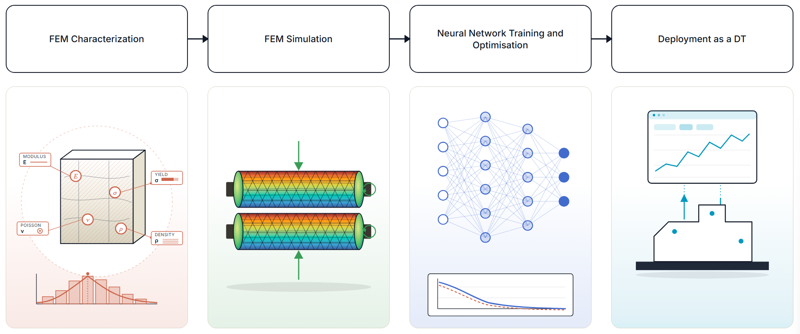
Research Proposal
The proposed research plan is to establish an FEM-NN for use with Roll-to-Roll (R2R) machine to optimize operation and maximize productivity.
https://www.surecontrols.com/blog/top-7-causes-of-wrinkles-in-web-handling/

Slide 8

Performing FEM - PyAnsys
The tool of choice for FEM is Ansys.
However, for the amount of data required for NN modelling, Ansys workbench is tedious and slow.
The better option is to use PyAnsys!
PyAnsys is a collection of open-source Python packages that provide Python interfaces to Ansys simulation products.
Advantages of PyAnsys
Automated and reproduceable
Always for easy parametric studies
Testable and Maintainable
Rich post processing capabilities
docs.pyansys.com
github.com/ansys
Notes:
Academic ansys license is supported by KIMM school
🔁
Automation & Reproducibility
Every step is code — fully reproducible, auditable, and shareable. No more "I don't remember which settings I used."
📐
Parametric Studies
Loop over hundreds of geometry or load variants in a for loop. Run overnight unattended — wake up to results.
🐍
Python Ecosystem
NumPy, SciPy, pandas, scikit-learn, PyTorch — ML-driven design, data fusion, and digital twin workflows alongside simulation.
🚀
CI/CD Integration
Regression-test your models. Run nightly solves in GitHub Actions. Catch physics regressions before they reach review.
☁️
HPC & Cloud Ready
PyHPS submits jobs to remote clusters. Scale from laptop to 1000-core HPC without changing your Python script.
📖
Open Source
MIT licensed, active GitHub community, transparent roadmap. Report bugs, contribute examples, or extend the API.
🔗
Multiphysics Orchestration
Chain Fluent + Mechanical + AEDT in one script via PySystemCoupling — CHT, FSI, EM-thermal — all automated.
📊
Rich Post-Processing
PyDPF returns results as NumPy arrays — combine with matplotlib or plotly for publication-quality custom plots.
🧪
Testable & Maintainable
Write pytest tests for simulation workflows. Code review simulation models like software. Version-control everything with Git.

Slide 9
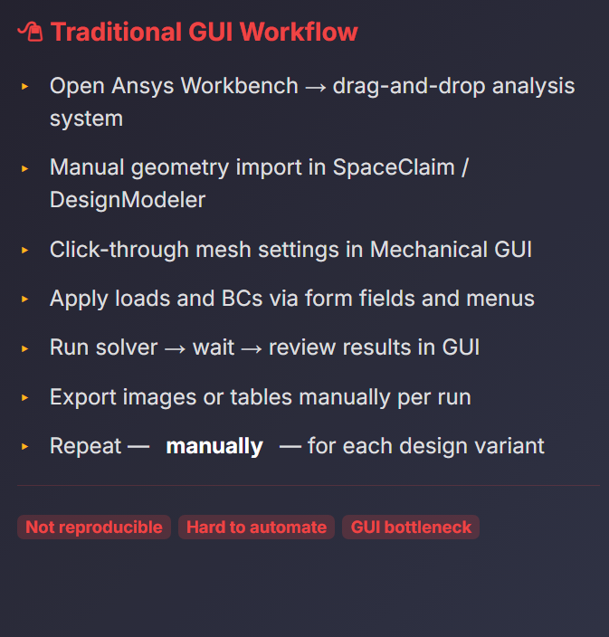
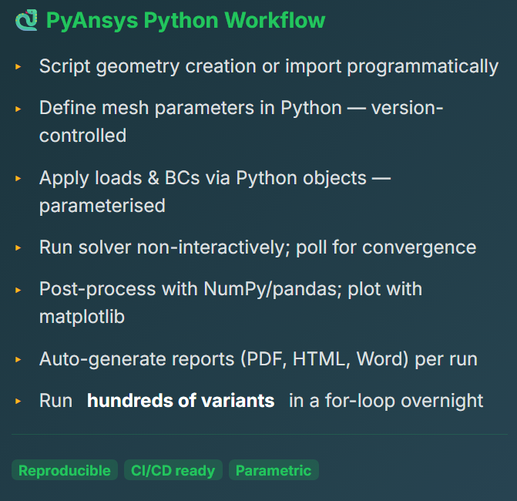
PyAnsys
Here we can see a simple comparison of the two methods.
docs.pyansys.com
github.com/ansys

Slide 10
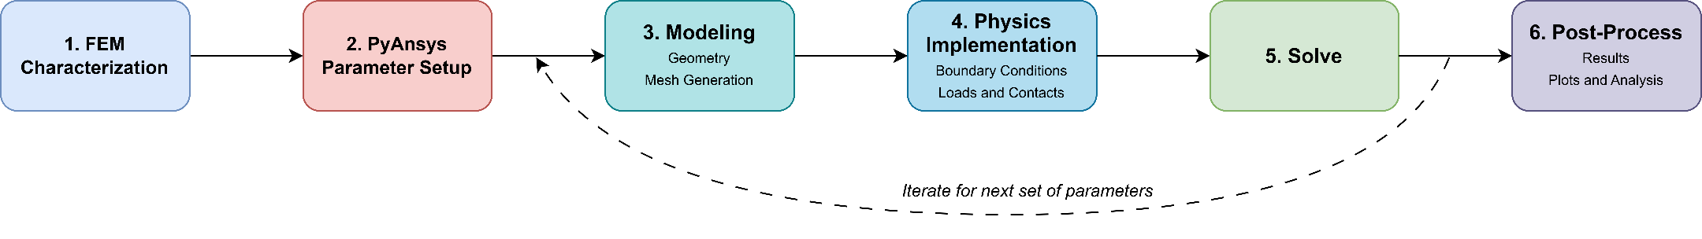
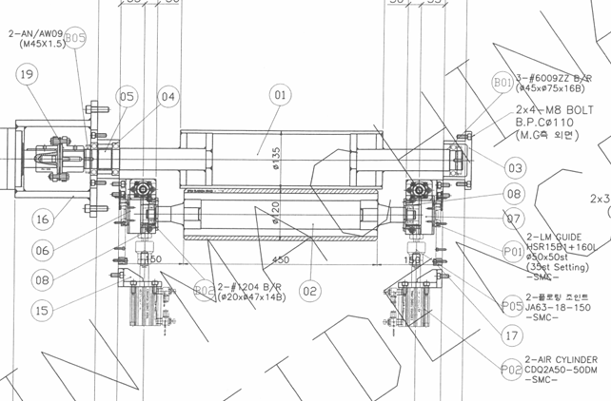
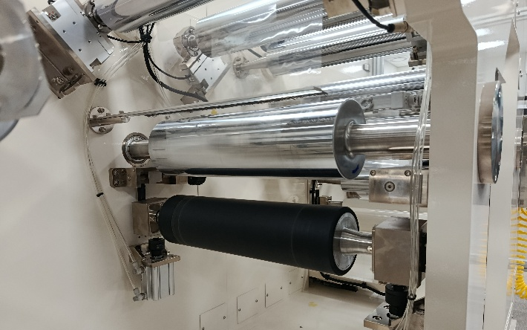
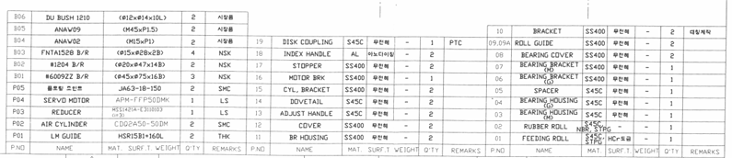
Current Progress and Workflow
FEM Characterization and Simulation
The first step was characterization of the R2R rollers for FEM, followed by the simulation process.
Step 1: The characterization was done using the physical machine and manuals:
Machine manuals detailing physical parameters
Notes:
PyMAPDL replication of the paper's baseline case:
D_rubber = 160 mm (rubber-roller OD, over rubber covering)
T_rubber = 7 mm (rubber covering RADIAL thickness, constant)
T_steel = 12 mm (steel wall RADIAL thickness - L9 parameter T)
D_master = 300 mm (simplified master roller OD)
L = 1200 mm (roller length; half-model uses L/2 = 600)
D_axis = 40 mm (journal diameter)
f = 3 N/mm (applied line load)
F_bearing = 1800 N (= f*L/2, the single modeled journal's bearing load)

Slide 11
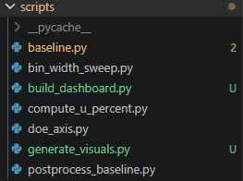
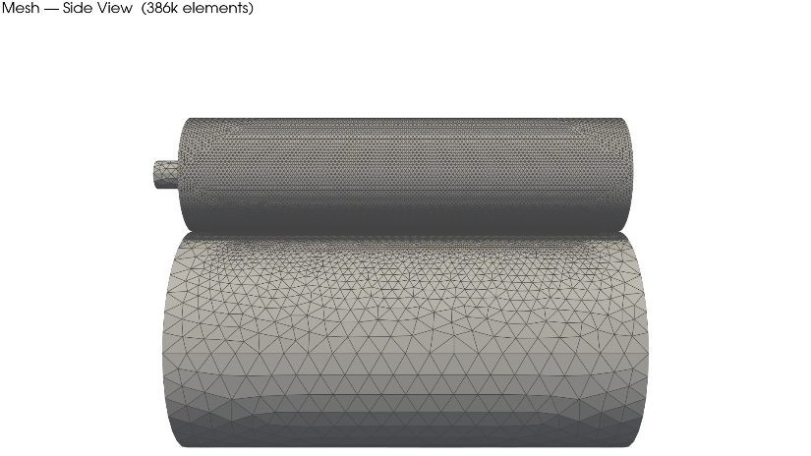
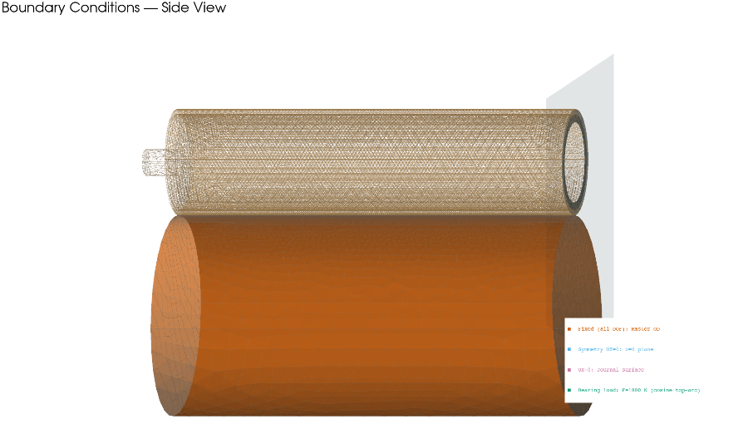
Current Progress and Workflow
Step 2: We set up the parametric process in PyAnsys, through the use of python scripts.
Step 3, 4 and 5: The PyAnsys scripts then call the Ansys solver and perform the Modeling, Physics Implementation, and Solve steps.

Slide 12
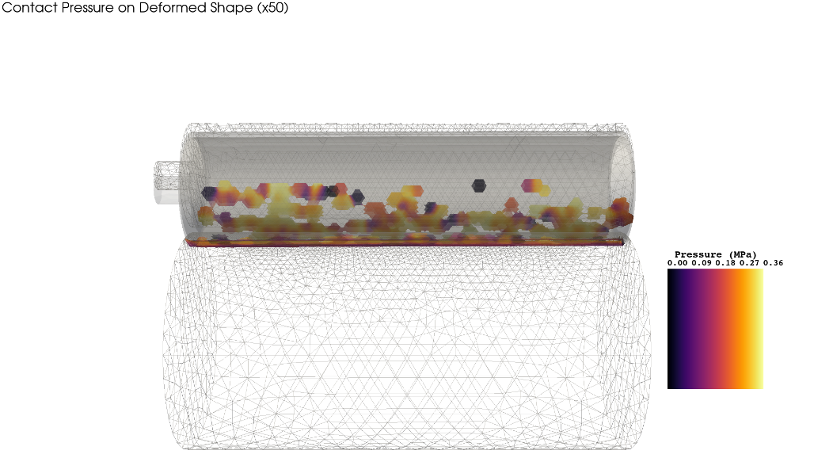
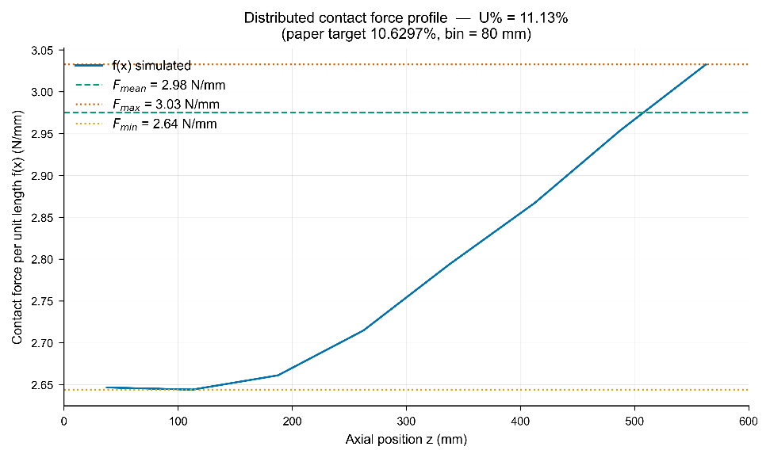
Current Progress and Workflow
Step 6: The post-processing script gives us renders of the desired variables, along with required graphs and values.
Iteration: The code then moves on to the next set of parameters.

Slide 13
Conclusions and Future Plan
Till now
FEM Characterization.
Initial FEM Simulation.
The first simulation to validate results and check for inconsistencies.
Future Plan
Implementation of the FEM-NN
Complete FEM and NN integration.
Validate against different test case models.
Digital Twin Integration
Integrate into automatic optimization control.
Explore natural language control.

Slide 14
Thank you!
Questions?
Algorithmic Intelligence Laboratory

